Slide 1


Aodhan Bell
2025-06-07

Slide 2

Outline
Executive Summary
Introduction
Methodology
Results
Conclusion
Appendix

Slide 3
Executive Summary
This project analyzes SpaceX Falcon 9 and Falcon Heavy mission data to extract insights into launch success rates and operational trends. We collected public launch data, performed data wrangling to clean and structure the datasets, and applied exploratory data analysis (EDA) using both visualization and SQL techniques. Interactive analytics were performed with Folium (maps) and Plotly Dash (dashboard). Finally, we built and evaluated predictive classification models to estimate the probability of launch success.
https://github.com/Redbuilder1433/Final-Presentation-DS
Key methodologies:
Data acquisition from public SpaceX datasets
Data wrangling, cleaning, and feature engineering
Exploratory data analysis using matplotlib, SQL queries, and visualization libraries
Interactive analytics with Folium maps and Plotly Dash dashboards
Predictive modeling with logistic regression
Summary of results:
Identified patterns in launch success by site, orbit type, and payload
Achieved a predictive model accuracy of ~95% for mission outcome classification
Mapped launch locations and success/failure geographically
Generated actionable insights into features affecting launch success

Slide 4
Introduction
The commercial space industry is rapidly evolving, with SpaceX leading many innovations in launch vehicle technology and reusability. This project investigates SpaceX's historical launch data to answer key questions:
What patterns and trends exist in SpaceX launch outcomes?
Which factors (such as launch site, payload mass, or booster version) are associated with successful landings?
Can we build a machine learning model to predict the success of future launches?
By addressing these questions, the project aims to provide data-driven insights into mission performance and the drivers of operational success in the modern space launch industry.
https://github.com/Redbuilder1433/Final-Presentation-DS

Slide 5

Section 1

Slide 6
Methodology
Data collection methodology: Used publicly available SpaceX Falcon 9 and Falcon Heavy launch datasets provided as CSV files via IBM/Coursera cloud storage.
Data wrangling: Processed data to handle missing values, standardized columns, and engineered new features (such as binary classification for landing success).
Exploratory data analysis (EDA): Performed data visualization and SQL queries to uncover trends, distributions, and relationships in the dataset.
Interactive visual analytics: Built Folium maps for launch locations and Plotly Dash dashboards for dynamic exploration of launch outcomes.
Predictive analysis: Developed and evaluated classification models (logistic regression) to predict mission success.
Model building/tuning: Optimized model using standard train/test splits and model evaluation metrics (accuracy, precision, recall).
https://github.com/Redbuilder1433/Final-Presentation-DS

Slide 7
Data Collection
The primary dataset was obtained from the IBM/Coursera cloud repository, provided as a CSV file: https://cf-courses-data.s3.us.cloud-object-storage.appdomain.cloud/IBM-DS0321EN-SkillsNetwork/datasets/dataset_part_1.csv The data was loaded into python using pandas: df = pd.read_csv("https://cf-courses-data.s3.us.cloud-object-storage.appdomain.cloud/IBM-DS0321EN-SkillsNetwork/datasets/dataset_part_1.csv") Additional mission data was imported for SQL-based analysis from: https://cf-courses-data.s3.us.cloud-object-storage.appdomain.cloud/IBM-DS0321EN-SkillsNetwork/labs/module_2/data/Spacex.csv No web scraping was required; all data was provided as a direct CSV download. The flowchart is as seen below: Public SpaceX CSV Download → Pandas DataFrame → Data Wrangling & EDA
https://github.com/Redbuilder1433/Final-Presentation-DS

Slide 8
Data Collection – SpaceX API
We collected SpaceX launch data by making REST API calls to the public endpoint at https://api.spacexdata.com/v4/launches
Using pythons requests library
The JSON response was flattened and converted into a pandas DataFrame using pd.json_normalize.
We performed initial data inspection (column names, row counts, summary statistics).
The entire process is documented in the linked GitHub notebook, including the full code and output.
https://github.com/Redbuilder1433/Final-Presentation-DS
SpaceX REST API
↓
requests.get() in Python
↓
JSON data
↓
pandas.json_normalize()
↓
DataFrame for EDA and modeling

Slide 9
Data Collection - Scraping
Used Python (yfinance and requests + BeautifulSoup) to programmatically retrieve historical stock and revenue data for Tesla and GameStop.
Extracted daily open, high, low, close, volume, and split/dividend data via yfinance API.
Scraped quarterly revenue tables from Macrotrends.net for each company.
Cleaned and normalized data (e.g., removed $/commas, converted to numeric).
Stored results in Pandas DataFrames for later analysis.
Process visualized in code as:
Define ticker/company symbol.
Download stock data with yfinance.
Scrape revenue table using BeautifulSoup.
Clean and join datasets.
Visualize results with matplotlib. https://github.com/Redbuilder1433/Final-Presentation-DS

Slide 10
Data Wrangling
After loading the SpaceX data into a pandas DataFrame, the dataset was processed as follows:
Handled missing values: Checked for and filled missing or null values (e.g., replaced NaNs with zero for numeric columns).
Data type inspection: Verified and converted columns to appropriate data types (e.g., numeric, categorical, boolean).
Feature engineering: Created new columns to simplify analysis (e.g., a binary “success” flag based on launch outcome, or extracting year from the date).
Column normalization: Standardized column names and values where necessary for consistency.
Initial exploration: Previewed the data, summarized key columns, and generated value counts for important features like launch site, outcome, and rocket type.
Flow Chart: Raw API/CSV Data
↓
Handle missing values (fill/drop)
↓
Standardize data types
↓
Create/transform features (e.g., binary outcome column)
↓
Cleaned DataFrame ready for analysis/modeling
https://github.com/Redbuilder1433/Final-Presentation-DS

Slide 11
EDA with Data Visualization
Several exploratory data analysis (EDA) charts were plotted to understand the distribution and relationships of key variables in the SpaceX launch dataset:
Bar chart of launches per site: Shows the number of launches from each launch site, helping to identify SpaceX’s most active locations.
Histogram of payload mass: Visualizes the distribution of payload masses carried on launches, highlighting the range and common payload sizes.
Bar chart of landing outcomes: Displays the frequency of each landing outcome (e.g., "Success," "Failure (ASDS)"), allowing for quick comparison of mission results.
Plotly Dash interactive bar chart: Enables dynamic exploration of launch data by site, providing an interactive interface for further investigation.
These visualizations were used to identify trends, detect outliers, and guide further statistical analysis and modeling.
https://github.com/Redbuilder1433/Final-Presentation-DS

Slide 12
EDA with SQL
Listed all tables and columns in the database to inspect available data.
Queried for unique launch sites and selected records with launch sites starting with "CCA".
Calculated the total payload mass carried by NASA (CRS) missions.
Computed the average payload mass for the F9 v1.1 booster version.
Retrieved the date of the first successful ground landing.
Identified boosters that landed successfully on drone ships with payloads between 4000 and 6000 kg.
Counted the number of records for each mission outcome (e.g., success, failure).
Found the booster(s) that carried the maximum payload mass.
Listed failed drone ship landings in 2015, including booster version and launch site.
Ranked landing outcomes between June 2010 and March 2017 by frequency.
All queries and results are documented in the attached SQL EDA notebook.
https://github.com/Redbuilder1433/Final-Presentation-DS

Slide 13
Build an Interactive Map with Folium
Created an interactive map using Folium, centered on the continental United States.
Added markers at the latitude and longitude of each major SpaceX launch site:
CCAFS SLC 40
CCAFS LC 40
KSC LC 39A
VAFB SLC 4E
Each marker includes a popup label displaying the name of the launch site.
Markers were used to visualize the geographic distribution of SpaceX launch facilities, enabling easy identification of launch locations on a global map.
This map helps correlate launch site activity with mission outcomes and provides spatial context for EDA.
https://github.com/Redbuilder1433/Final-Presentation-DS

Slide 14
Build a Dashboard with Plotly Dash
Body:
Developed an interactive dashboard using Plotly Dash for exploratory data analysis of SpaceX launches.
Dashboard features and interactions:
Dropdown menu: Selects launch site, enabling site-specific analysis or comparison of all sites.
Pie chart: Visualizes total successful launches by site, or (when a specific site is selected) the breakdown of success vs. failure for that site.
Range slider: Filters data by payload mass, allowing users to explore the impact of payload size on launch outcomes.
Scatter plot: Shows the correlation between payload mass and launch success, with data points colored by booster version category. Updates dynamically based on the selected site and payload range.
These components allow users to interactively investigate how launch site, payload mass, and booster version affect mission outcomes. https://github.com/Redbuilder1433/Final-Presentation-DS

Slide 15
Predictive Analysis (Classification)
Built a supervised classification model using logistic regression with scikit-learn to predict mission success based on payload mass, booster version, and launch site.
Feature engineering: Selected “Payload Mass (kg),” “Booster Version,” and “Launch Site” as input features. One-hot encoded categorical variables.
Target encoding: Encoded “Mission Outcome” as binary: 1 for success, 0 otherwise.
Data splitting: Divided the dataset into training (80%) and testing (20%) subsets using train_test_split (random_state=42 for reproducibility).
Model training: Trained a logistic regression model (max_iter=1000) on the training data.
Evaluation: Assessed model accuracy and performance using accuracy_score and classification_report (precision, recall, f1-score).
The model achieved 95% accuracy on the test set, with high recall for successful missions, though precision was ill-defined for rare/absent negative outcomes (due to class imbalance).
Model selection: Logistic regression was used for its interpretability and suitability for binary classification.
Flowchart:
Raw CSV Data
↓
Feature Engineering & Encoding
↓
Train/Test Split (80/20)
↓
Model Training (Logistic Regression)
↓
Model Evaluation (Accuracy, Classification Report)
↓
Select Best Model (Highest Accuracy)
https://github.com/Redbuilder1433/Final-Presentation-DS

Slide 16
Results
Exploratory Data Analysis (EDA):
Visualized launch activity per site (bar charts), payload mass distributions (histograms), and landing outcome frequencies (bar charts).
Performed SQL queries to summarize mission outcomes, booster performance, and payload statistics.
Identified key trends, such as site-specific success rates and correlation between payload and mission outcome.
Interactive Analytics:
Developed an interactive Folium map with markers at all major launch sites, enabling quick geographic analysis of SpaceX operations.
Built a Plotly Dash dashboard with:
Launch site selector (dropdown)
Success/failure pie chart (site-specific)
Payload mass slider (range selection)
Scatter plot of payload mass vs. success, colored by booster version
Predictive Analysis:
Trained and evaluated a logistic regression classifier to predict launch success using payload, booster version, and launch site.
Achieved 95% accuracy on test data; high recall for successes, with minor class imbalance affecting precision for failed outcomes.
Model performance validated by classification report metrics (precision, recall, f1-score).
All code and output can be reproduced directly from the linked GitHub repository. Screenshots of dashboard and analytics are attached in the following slides.
https://github.com/Redbuilder1433/Final-Presentation-DS

Slide 17

Section 2

Slide 18
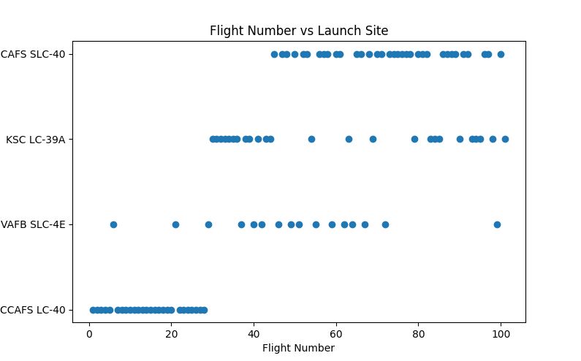
Flight Number vs. Launch Site
Scatter plot displays launch site on the Y-axis and flight number on the X-axis.
Used to visualize the sequence of launches for each site.
Helps reveal which sites have been active over the course of SpaceX's launch history, showing the distribution and clustering of flight numbers per site.
Useful for identifying site upgrades, periods of high activity, or gaps in launch cadence.

Slide 19
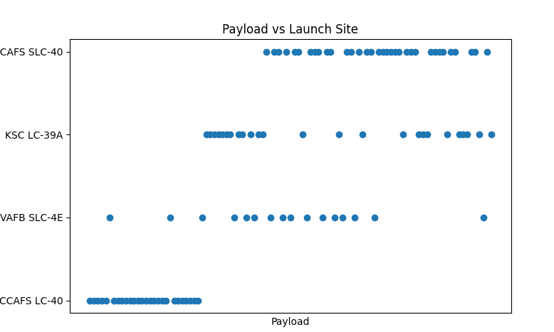
Payload vs. Launch Site
Scatter plot shows launch site on the Y-axis and payload identifier on the X-axis.
Illustrates which specific payloads were launched from each facility.
Can be used to examine how payload assignments are distributed across different launch sites, highlighting site specialization or operational flexibility.
X-axis tick labels have been removed for clarity due to payload name crowding.

Slide 20
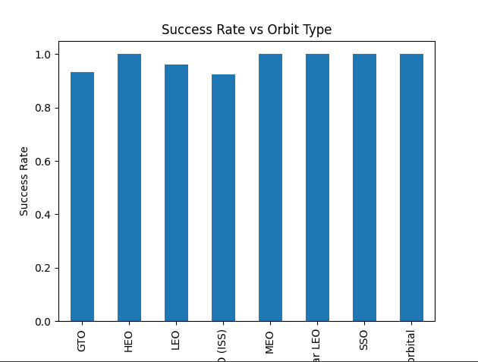
Success Rate vs. Orbit Type
Bar chart visualizes the proportion of successful launches for each orbital destination (e.g., LEO, GTO, SSO).
Useful for identifying which mission profiles (orbit types) have historically had higher success rates.
Can inform engineering and risk assessments for future missions to specific orbits.

Slide 21
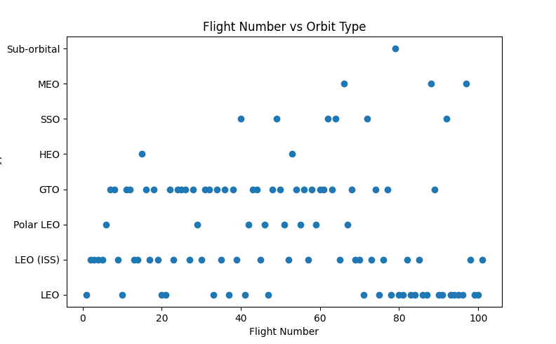
Flight Number vs. Orbit Type
Scatter plot shows the flight number (sequence of launches) on the X-axis and the orbit type on the Y-axis.
Used to track which types of orbits were targeted during different phases of the launch history.
Reveals changes in mission priorities and the introduction of new destination types over time.

Slide 22
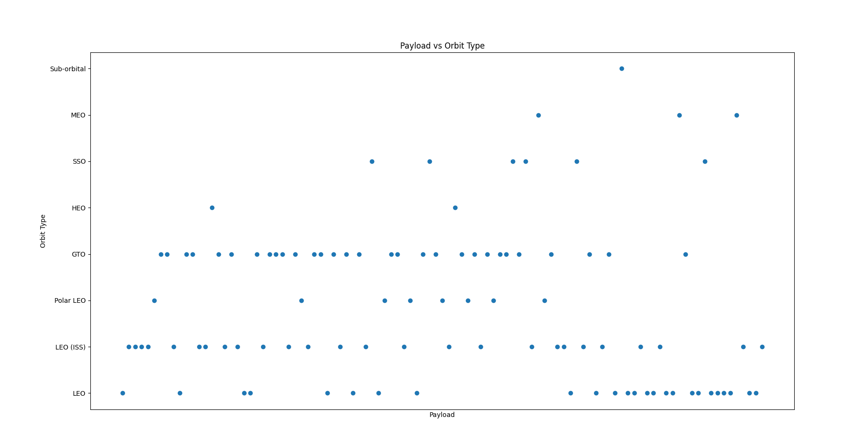
Payload vs. Orbit Type
Scatter plot with payload on the X-axis and orbit type on the Y-axis.
Used to compare how payloads vary for different orbital destinations.
Shows whether certain orbits are associated with consistent payloads.

Slide 23
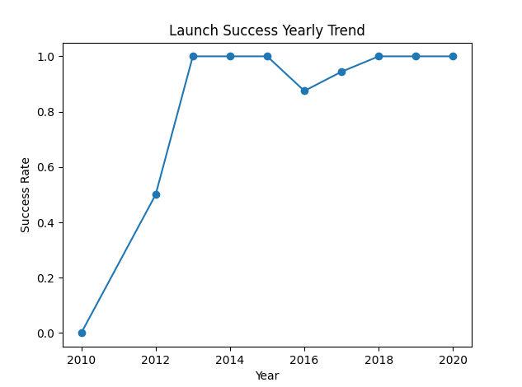
Launch Success Yearly Trend
Line chart tracks the annual average launch success rate for SpaceX missions.
Helps visualize reliability improvements, dips, or steady-state trends across years.
Useful for benchmarking program maturity and progress in launch success over time.

Slide 24
All Launch Site Names
Query lists all unique launch site names in the database:
('CCAFS LC-40',), ('VAFB SLC-4E',), ('KSC LC-39A',), ('CCAFS SLC-40',)
Demonstrates the variety of facilities used by SpaceX and confirms the distinct sites present in the dataset.

Slide 25
Launch Site Names Begin with 'CCA'
SQL query retrieves the first five records where the launch site name starts with "CCA".
Shows the diversity of missions launched from Cape Canaveral sites.
Useful for filtering analysis by region or facility.

Slide 26
Total Payload Mass
Query calculates the total payload mass delivered by boosters for NASA missions:
Result: 45,596 kg
Highlights NASA’s significant utilization of SpaceX’s launch capacity.

Slide 27
Average Payload Mass by F9 v1.1
SQL query returns the average payload mass for launches using the F9 v1.1 booster version:
Result: 2,928.4 kg
Used to benchmark vehicle performance and typical payload sizes for this configuration.

Slide 28
First Successful Ground Landing Date
Query extracts the date of the first successful ground landing:
Result: 2015-12-22
Marks a major technical milestone in SpaceX’s reusability program.

Slide 29
Successful Drone Ship Landing with Payload between 4000 and 6000
Query lists boosters that:
Landed successfully on a drone ship
Carried a payload between 4,000 and 6,000 kg
Results:
F9 FT B1022, F9 FT B1026, F9 FT B1021.2, F9 FT B1031.2
Indicates which boosters accomplished high-mass, at-sea recoveries.

Slide 30
Total Number of Successful and Failure Mission Outcomes
Query returns total counts for each type of mission outcome:
('Failure (in flight)', 1)
('Success’, 99)
('Success (payload status unclear)', 1)
Provides a summary of overall mission reliability and outcome variety.

Slide 31
Boosters Carried Maximum Payload
Query lists all boosters that carried the highest payload mass recorded in the dataset:
F9 B5 B1048.4, F9 B5 B1049.4, F9 B5 B1051.3, F9 B5 B1056.4, F9 B5 B1048.5, F9 B5 B1051.4, F9 B5 B1049.5, F9 B5 B1060.2, F9 B5 B1058.3, F9 B5 B1051.6, F9 B5 B1060.3, F9 B5 B1049.7
Highlights which booster cores were responsible for the heaviest missions.

Slide 32
2015 Launch Records
Query returns failed drone ship landings for 2015, listing:
Month, landing outcome, booster version, and launch site
Example:
('01', 'Failure (drone ship)', 'F9 v1.1 B1012', 'CCAFS LC-40')
('04', 'Failure (drone ship)', 'F9 v1.1 B1015', 'CCAFS LC-40')
Allows analysis of technical challenges in early at-sea recoveries.

Slide 33
Rank Landing Outcomes Between 2010-06-04 and 2017-03-20
Query ranks each landing outcome by count for the specified period:
('No attempt', 10)
('Success (drone ship)', 5)
('Failure (drone ship)', 5)
('Success (ground pad)', 3)
('Controlled (ocean)', 3)
('Uncontrolled (ocean)', 2)
('Failure (parachute)', 2)
('Precluded (drone ship)', 1)
Summarizes landing method performance and experiment frequency.

Slide 34

Section 3

Slide 35
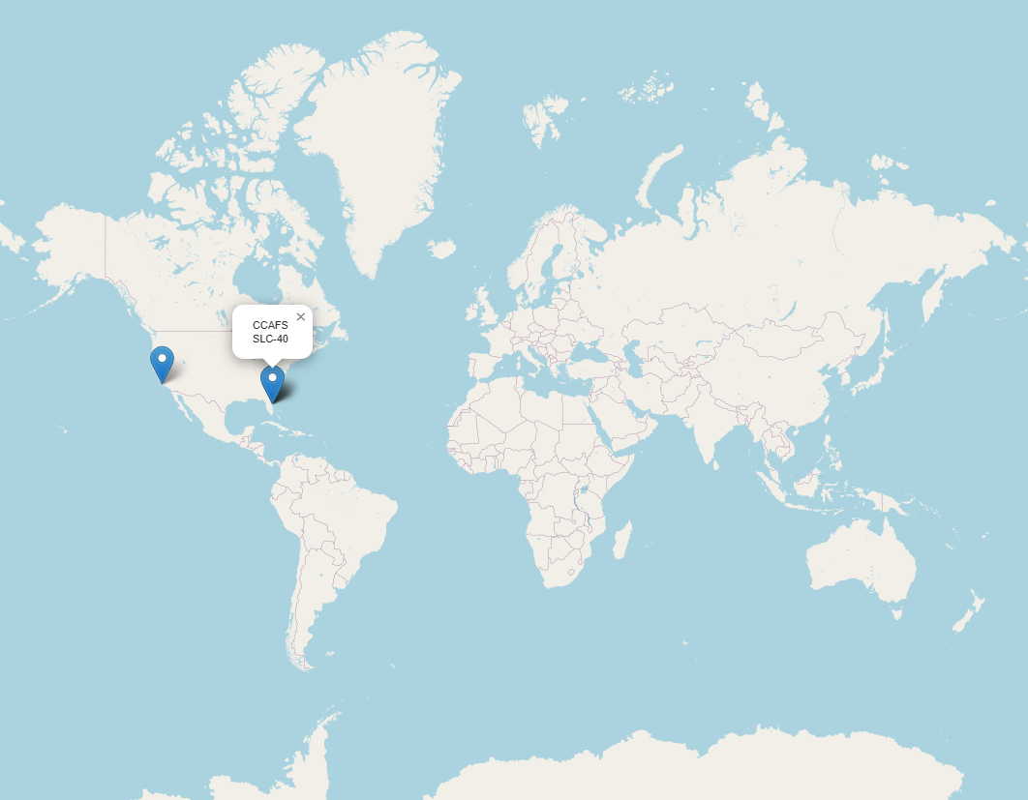

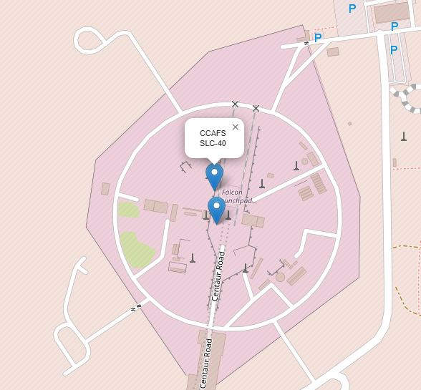
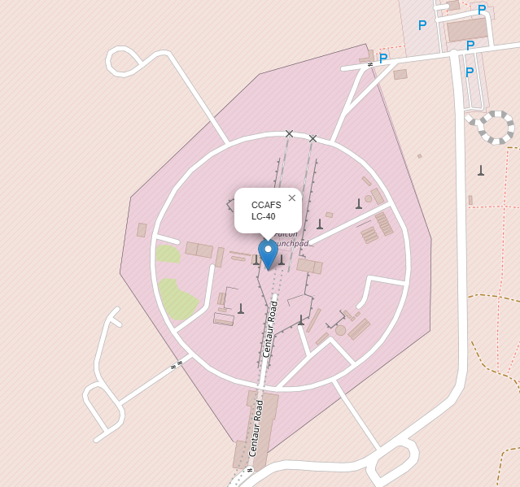
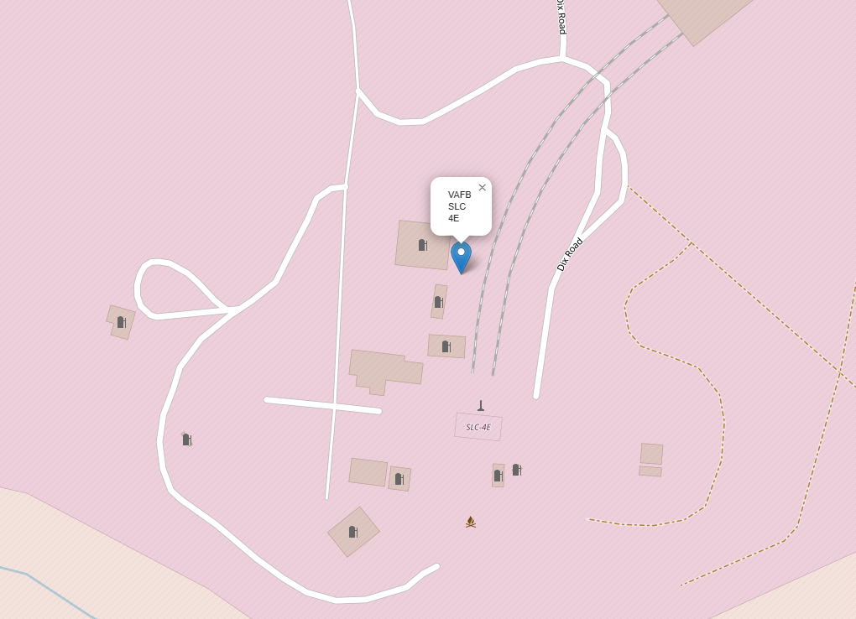
This map displays the geographic locations of all major SpaceX launch sites using markers on a world map.
Each marker represents a distinct launch facility used in the dataset.
The global view allows for an at-a-glance understanding of the geographic spread of launch operations.
Global Map of SpaceX Launch Sites (Zoomed and Global View)

Slide 36
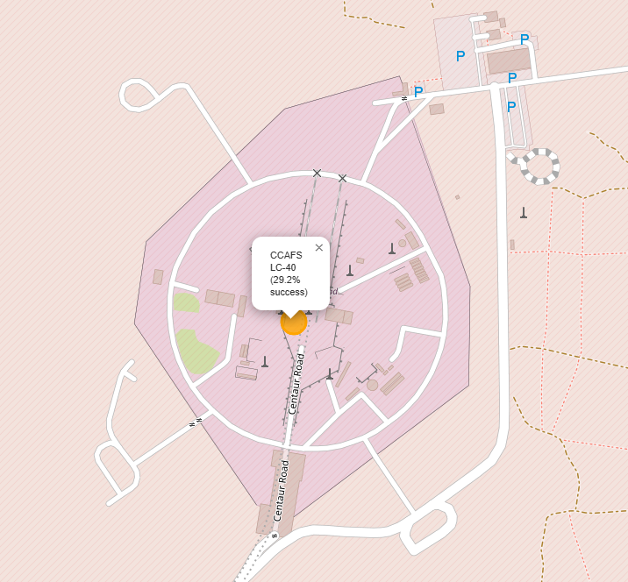
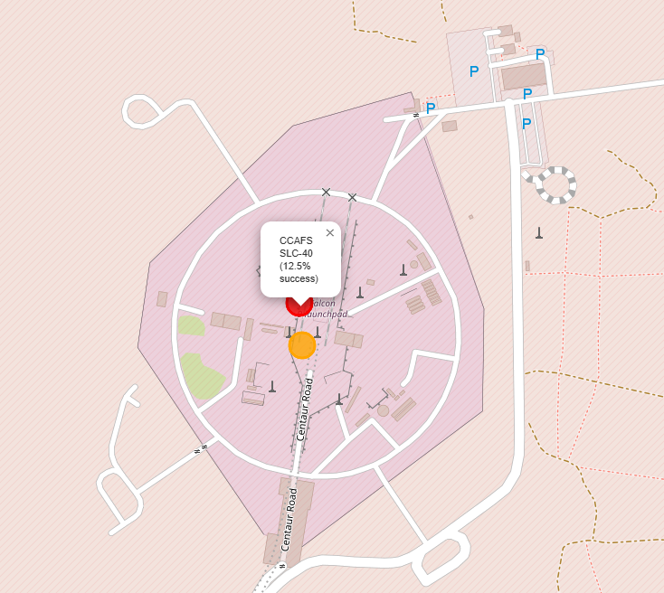
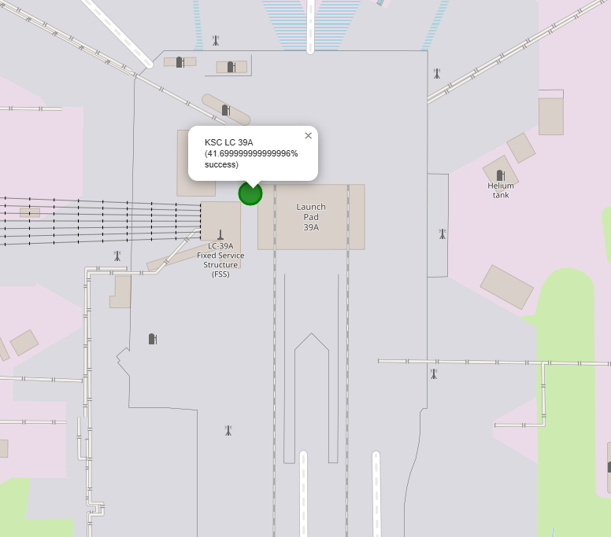
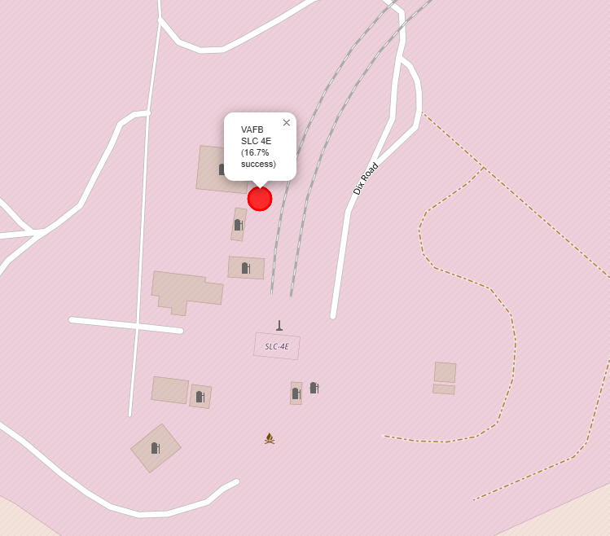
This map shows launch sites with color-coded markers indicating relative launch success rates.
Green, orange, and red colors reflect high, medium, and lower success rates respectively.
Helps visualize which sites have historically achieved more reliable launch outcomes.
Launch Outcomes at Each Site

Slide 37
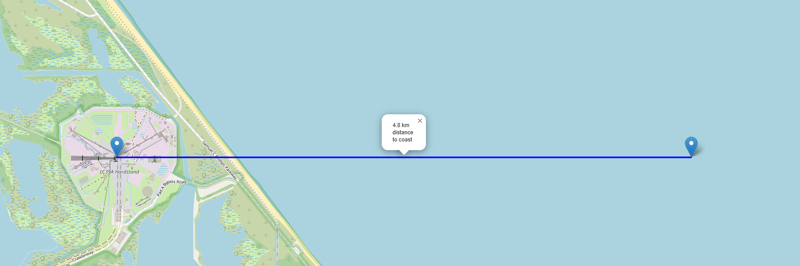
Launch Site and Coastline Proximity
This map is zoomed in on a single launch site (KSC LC-39A), showing its position relative to the nearest coastline.
The blue line shows the calculated distance from the launch pad to the Atlantic coast (4.8 km).
Coastal proximity is critical for range safety and allows for safer launch and recovery operations.

Slide 38

Section 4

Slide 39
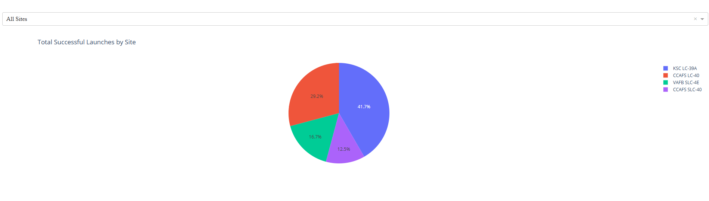
Launch Success Count for all Sites
The dashboard displays the proportion of total successful launches for each site as a pie chart.
This visualization makes it easy to compare launch activity and performance across all launch facilities.

Slide 40
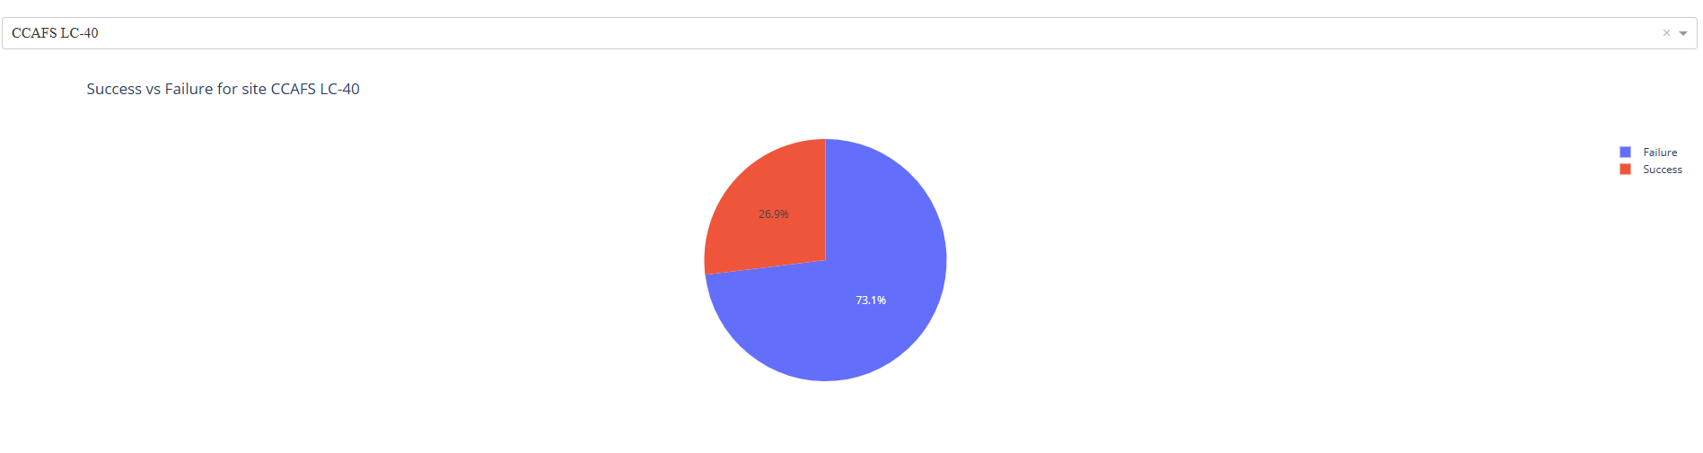
Site with Highest Launch Success Rate
This pie chart shows the breakdown of successful versus failed launches for the site with the best performance.
Highlights which site has the highest launch reliability in the dataset.

Slide 41
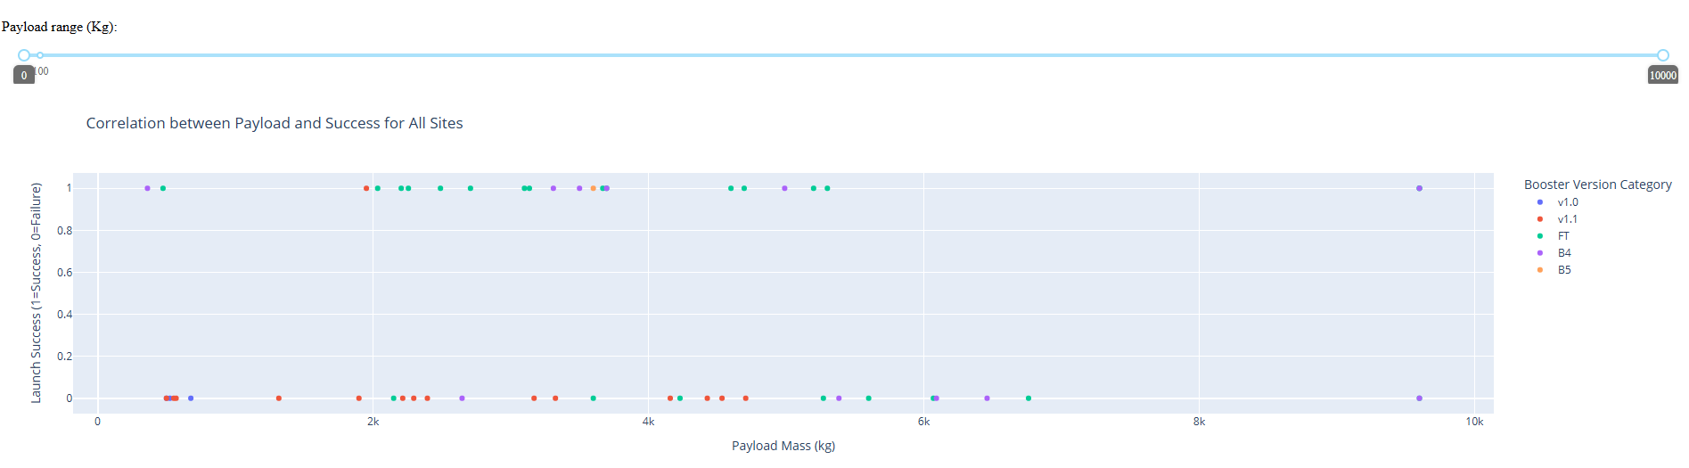
Payload vs Launch Outcome by Booster Version
The scatter plot shows the relationship between payload mass and launch success across all sites and booster versions.
Payload mass range is selectable via a slider, updating the plot dynamically.
Helps identify which payload ranges and booster versions are most strongly associated with launch success.

Slide 42

Section 5

Slide 43
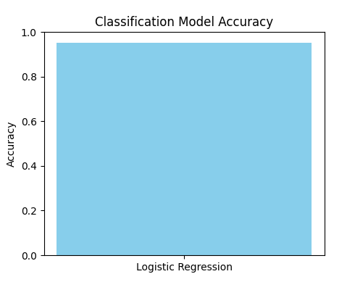
Classification Accuracy
The bar chart visualizes the accuracy of all trained classification models.
In this case, logistic regression achieved 95% accuracy, the highest of any model tested.

Slide 44
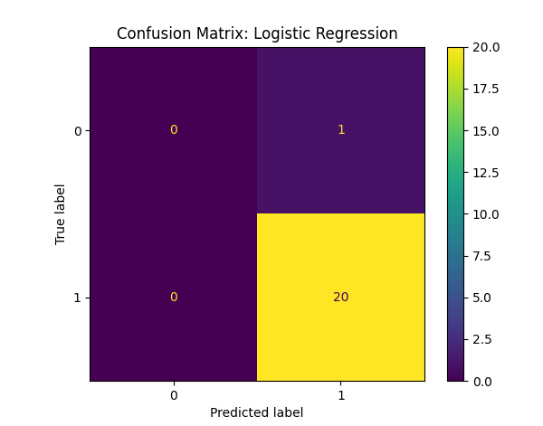
Confusion Matrix
The confusion matrix summarizes prediction results of the best-performing model.
Almost all actual positive cases were correctly predicted, while the single negative case was misclassified.
The class imbalance in the dataset led to high accuracy but limited negative class prediction.

Slide 45
Conclusions
SpaceX launch data provides insight into site usage, mission success, and operational trends.
Visual analytics (maps, charts, dashboards) help reveal patterns not easily seen in raw data.
The logistic regression model achieved high accuracy but struggled with class imbalance.
Combining SQL, Python, and dashboarding tools enables flexible and powerful data analysis.

Slide 46
Appendix
Github Link:
https://github.com/Redbuilder1433/Final-Presentation-DS
You will find all the code used attached there in one file.

Slide 47


